Slide 1

It’s no longer your typical myp
The views and opinions expressed in this presentation are those of the authors and do not
necessarily reflect those of CASBO.

Slide 2
Sacramento Section Contributors
Catherine Hawes, Sutter County Superintendent of Schools
Terri Ryland, Ryland | School Business Consulting
Jennifer Stahlheber, Sutter County Superintendent of Schools

Slide 3
Introduction
Why This Topic?
What Are the Issues?
Components and Approach
Hints
Presenting Clearly

Slide 4
Why MYP?
Planning is a good idea!
Yes, the numbers in your MYP will be wrong
  But, we need to have a financial plan
We take the latest, most reasonable assumptions and apply them to our revised budget to look at the future for our LEA
Without this planning tool, there are too many surprises that can impede or completely stop educational progress in the budget or future years

Slide 5

What is the Big Deal?
Revenue projections are volatile
  We must get a good idea of the current year projections, then we can make assumptions for the future
  We need a tool that we can update quickly to reflect changes that occur all year
  While AB1200 requires a current year plus two-year projection, it is just a best practice

Slide 6
What to Have Before You Get Started
Assumptions included in the current revised budget
Enrollment projections, ADA trends
LCFF calculator
List or identification of one-time revenues and expenditures
Staffing ratios and projected FTE changes for budget year
Cost of step, column, retirement incentives, retirement increases
Impact of negotiations, minimum wage implications
Board approved budget reductions
LCAP priorities and changes

Slide 7
Set Up MYP Template
Set up workbook so the assumptions tab feeds the MYP tab
Identify assumptions (changes between years) by
  Object code and
  Unrestricted/ Restricted
Add third ‘out year’
  With recent, and future, changes to gap funding and economic factors, showing the third year at interim reporting times will prevent surprises when it shows up as the second year out in May/June for Adopted Budget
Have charts, graphs, summaries, and trends that feed off of the MYP numbers

Slide 8

Assumptions to Include
Revenue
  LCFF changes between years (gap funding and/or property taxes, net of enrollment changes)
  One-time funds added and removed
  Changes in contributions to restricted programs
    Reduced revenues in restricted programs
    Increased costs of employees
    RRM back to 3% level
  Federal budget cuts?

Slide 9

Assumptions to Include
Expenditures
  FTE changes
  Negotiated changes
  STRS/PERS increases
  Minimum wage implications each year
  Health benefit cap changes
  Step/column increases
  Remove/add one-time expenditures
    Curriculum, capital expenditures, professional development
  Reflect board-approved budget reductions and/or new programs
  Include LCAP priorities

Slide 10
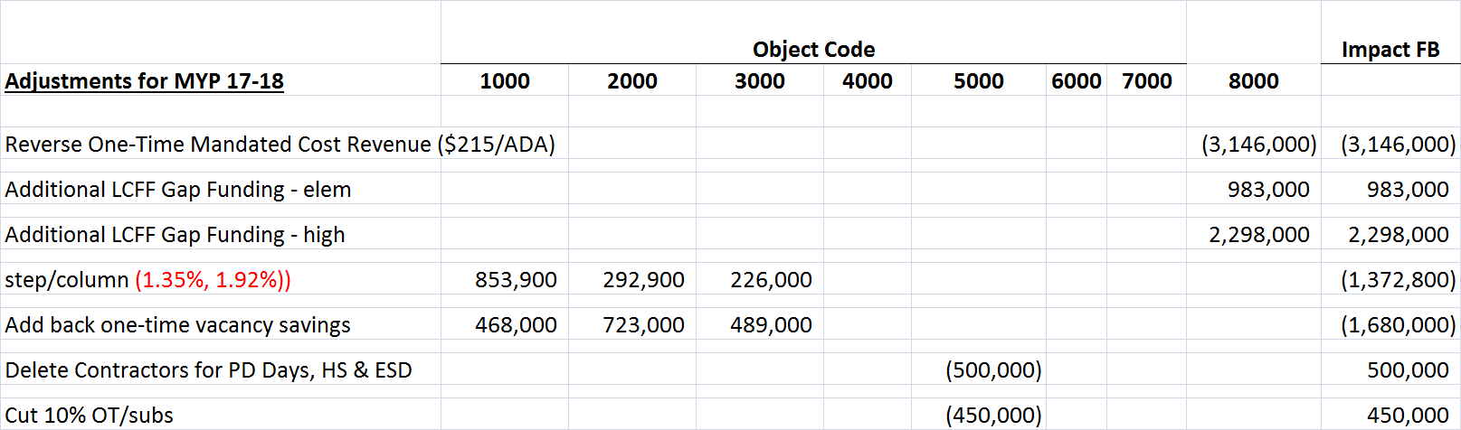
Assumptions by Object Code
Unrestricted assumptions include revenues, salary changes, one-time contracts, budget reductions…

Slide 11
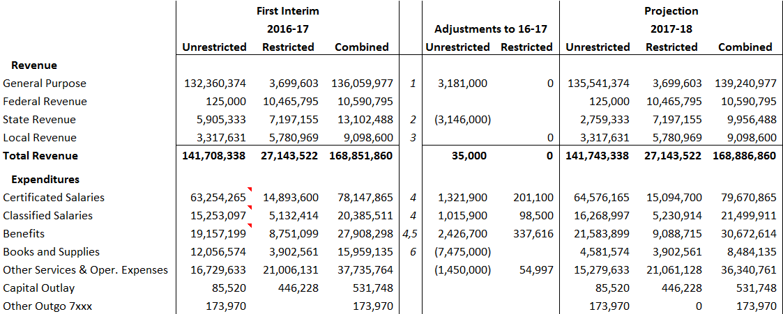
Link the Assumptions to the MYP
Bring in a summary of assumptions by object code

Slide 12
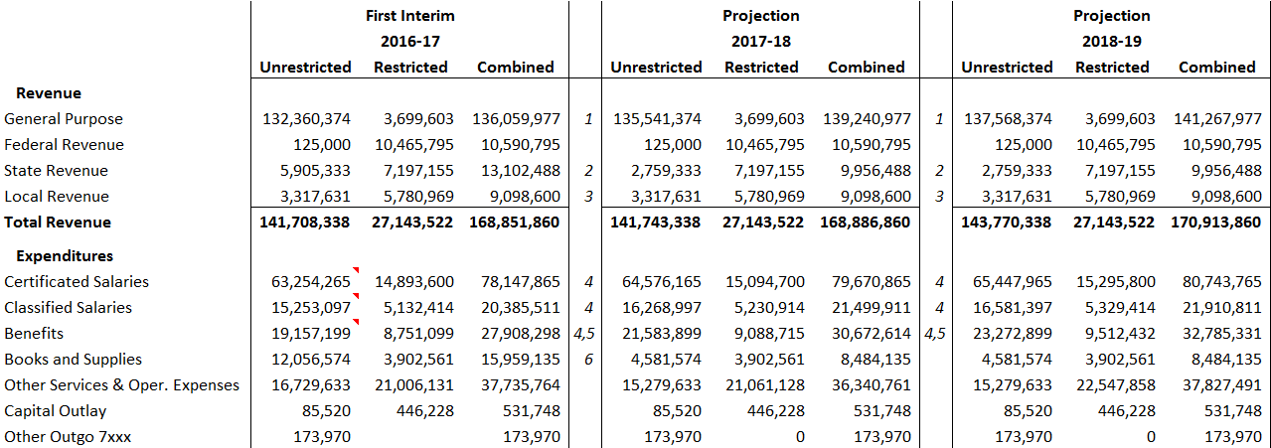
Format of a MYP
Be sure to have one page in a SACS format that shows all three years
  It’s a lot of numbers, but one slide with the full picture isn’t a bad idea!

Slide 13
What Are Some Common Mistakes?
Not listing assumptions prominently
  The math is easy; it is all up to the assumptions
  Be clear
Not adjusting for one-time revenues and expenditures
  Textbook adoption one year and not the other
  One-time mandated cost revenue
Not using updated enrollment/ADA projections for revenue and staffing
Over-estimating property tax increases
  Basic Aid and cash flow implications
Padding budgets and ending up with too much budget savings
“Fixing” the problem yourself by shaving costs or assuming things will be better without listing or discussing those critical changes

Slide 14
Extras For a Better Product
Add the third year out to reduce surprises
  Many boards were shocked last May/June when they saw the bottom drop out of their budgets in 2018-19
  Unless they had been shown current plus THREE, they had no idea things looked so grim once Prop 30 was projected to go away
LCAP MYP
Charts, graphs and summaries

Slide 15
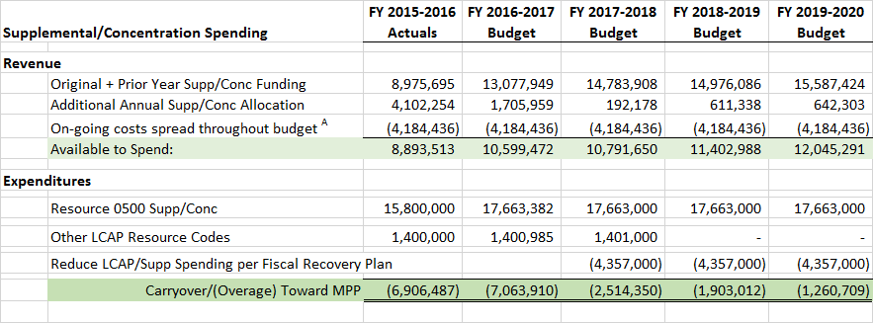
LCAP MYP
Projecting supp/conc funds that have been spent and are to be spent to be sure meeting MPP

Slide 16
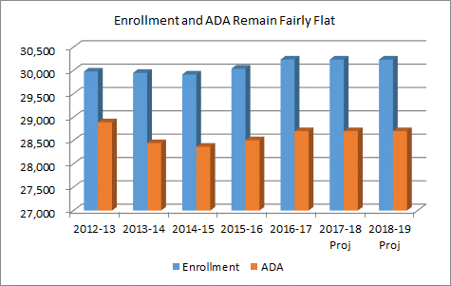
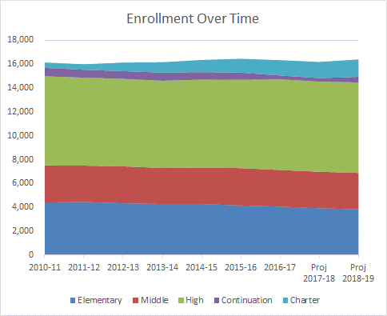
Charts, Graphs, Summaries
Be clear on enrollment and ADA trends

Slide 17
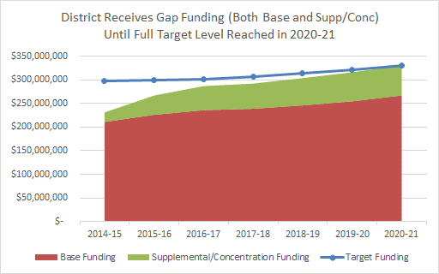
Explaining the “Gap”
Use a chart to explain LCFF funding
Full Gap Funding

Slide 18
Have A Summary Budget to Discuss
While we focus on Unrestricted, be sure the board and cabinet understand that categorical programs are part of the “General Fund”

Slide 19
Then Summarize the MYP
Highlight surplus/(deficit) and ending fund balance

Slide 20
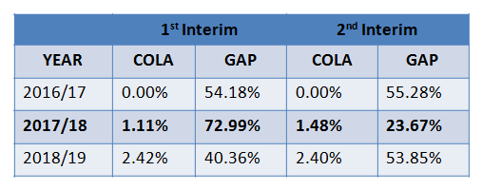
Compare Rates and Assumptions
Showing the changes between periods, sometimes significant changes such as the gap funding change this year, reminds everyone of the fluid nature of our budgets
  This helps explain why our numbers are always “wrong”!

Slide 21
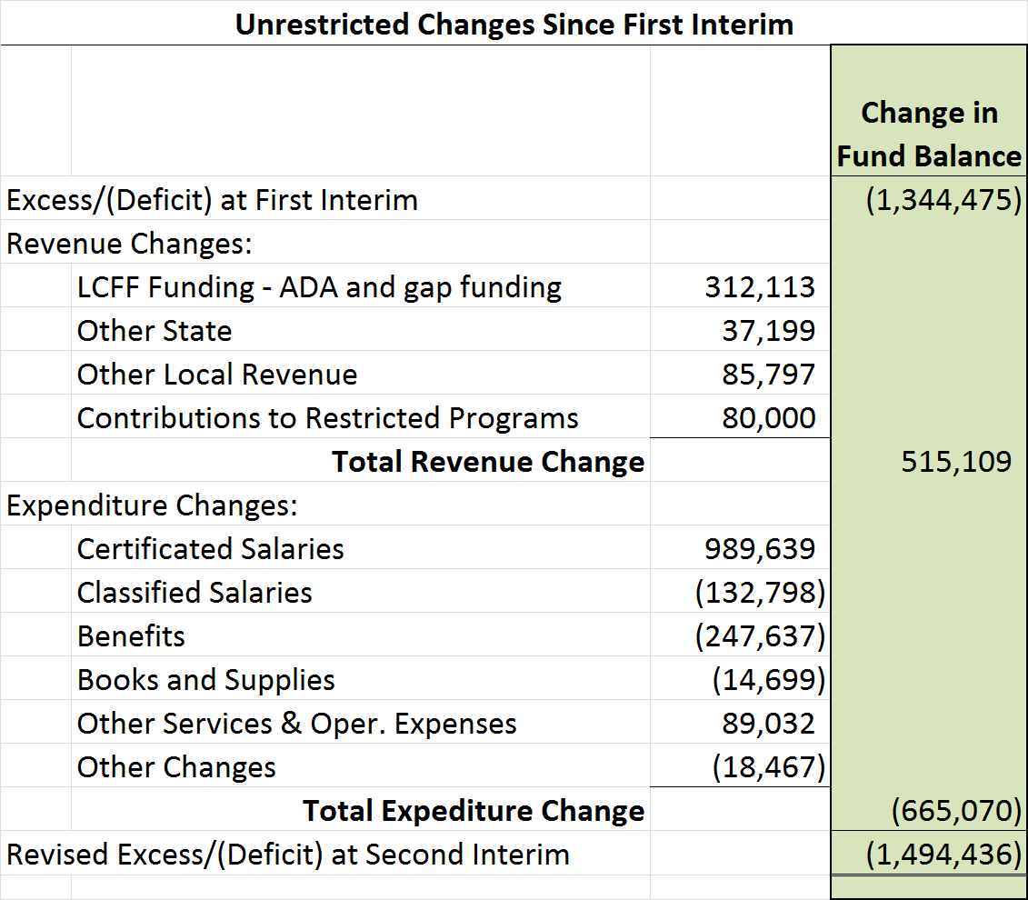
Analyze the Change Between Periods
Being able to explain the changes will assure yourself that you understand and confirm that the numbers are solid

Slide 22
PERS and STRS Changes Must Be Clear
Keep the updated rates in front of the board and unions
  Total compensation is increasing dramatically
CalSTRS Rates per EC§ 22901.7 and 22950.5
 | 2014-15 Actual | 2015-16 Actual | 2016-17 Actual | 2017-18 Projected | 2018-19 Projected | 2019-20 Projected | 2020-21 Projected
Employer | 8.880% | 10.73% | 12.58% | 14.43% | 16.28% | 18.13% | 19.10%
Member (2% at 60) | 8.150% | 9.20% | 10.25% | 10.25% | 10.25% | 10.25% | 10.25%
Member (2% at 62) | 8.150% | 8.56% | 9.205% | 9.205% | 9.205% | 9.205% | 9.205%
 | increase | 1.85% | 1.85% | 1.85% | 1.85% | 0.97% | 0.97%
CalPERS Actual and Projected Rates
 | 2014-15 Actual | 2015-16 Actual | 2016-17 Actual | 2017-18 Projected | 2018-19 Projected | 2019-20 Projected | 2020-21 Projected
Employer | 11.771% | 11.85% | 13.05% | 16.60% | 18.20% | 19.90% | 20.40%
 | Increase | 0.079% | 1.200% | 3.550% | 1.600% | 1.700% | 0.500%

Slide 23
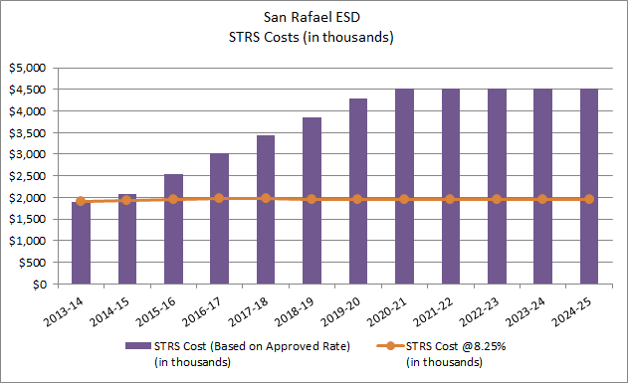
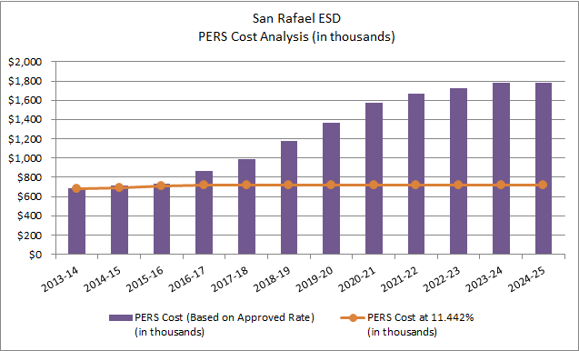
Compare STRS/PERS Current to Future
Find a way to demonstrate the more than doubling of the rates/costs

Slide 24

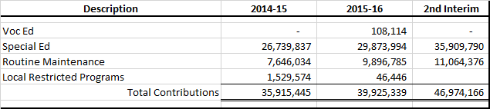
Contributions
Highlight contributions to restricted programs
  Make sure only board-approved contributions are made
    i.e. if board policy is that only special education and routine maintenance have contributions, be sure other programs stay within their revenue allocations

Slide 25
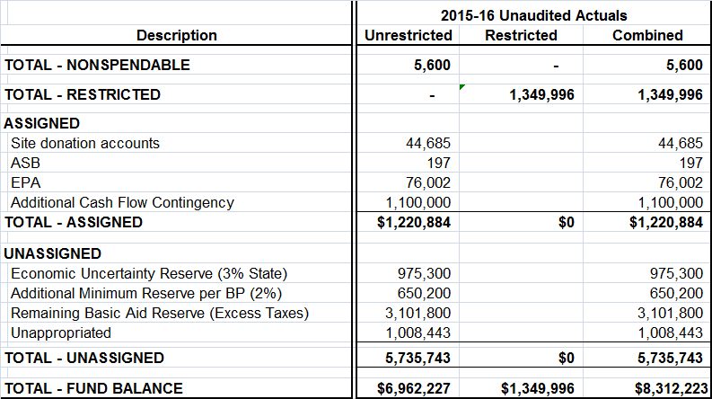
Components of Fund Balance
At budget adoption, disclose the components of fund balance and justify the reserves

Slide 26
Surpluses and Deficits
Deficit spending should be shown in context and trends are helpful for explaining

Slide 27
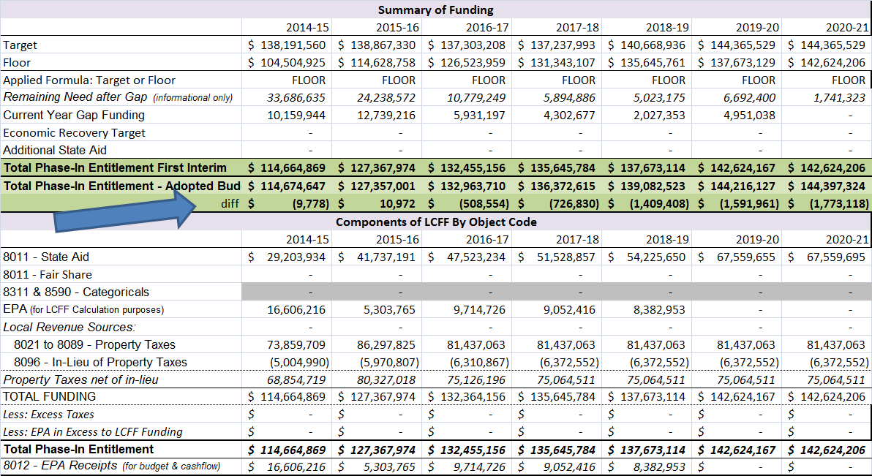
LCFF Funding
Compare LCFF funding between periods

Slide 28
It’s Not Your Mother’s MYP
Be clear, concise, and forthcoming
  No budget padding allowed!
There are a lot of moving parts
Stay up to date on the latest State and Local economic indicators and assumptions
Revisit the projections regularly
  Run “what ifs” for negotiations or funding scenarios
The MYP can be a useful teaching tool with community groups, unions, and administrators

Slide 29
Questions and Contact Info
Questions?
Catherine and Jennifer
  (530) 822-2942 Catherine and (530) 822-2928 Jennifer
  catherineh@sutter.k12.ca.us
  jenniferst@sutter.k12.ca.us
Terri
  (916)652-7165
  terri@rylandsbc.com
  www.rylandsbc.com

